Slide 1
Computer Architecture Experiment
Topic 7. Pipelined CPU accessing Mem. in multiple cycle
浙江大学计算机学院
陈文智
chenwz@zju.edu.cn

Slide 2
实验操作流程
阅读实验文档，理解存储器的等待周期对性能的影响
以前一次实验为基础，修改Memory访问机制为多个时钟周期访问时间，CP0增加CPU Tick计算功能，并测试实际循环指令执行效果，分析实际存储器对CPU性能的影响。
对处理器进行仿真，检验处理器的仿真结果是否符合要求。
综合工程并下载至开发板，在单步执行的过程中检查调试屏幕的输出，检验处理器的执行过程是否正确。

Slide 3
实验验收标准
仿真执行过程中，处理器的行为和内部控制信号均符合要求。
下载至开发板后的单步执行过程中，寄存器的变化过程和最终执行结果与测试程序相吻合。

Slide 4
Outline
Experiment Purpose
Experiment Task
Basic Principle
Operating Procedures
Precaution
Checkpoints

Slide 5
Experiment Purpose
Understand the principle of CPU accessing Mem. in multiple cycle and it’s affection to CPU.
Master the design methods of pipelined CPU accessing Mem. in multiple cycle.
master methods of program verification of Pipelined CPU accessing Mem. in multiple cycle.

Slide 6
Experiment Task
Design of Pipelined CPU accessing Mem. in multiple cycle
Redesign Inst. ROM & Data RAM
Modify CPU Controller
Modify datapath
Verify the Pipelined CPU with program and observe the execution of program

Slide 7
Access Mem. in multiple cycles
While accessing Mem., 8 cycles for addressing, get value and delivery(or addressing, delivery and put value).
Another cycle for reset signal “ACK”(used for cache)
Above all, for accessing mem., it needs 9 cycle, and stalls the pipeline in 8 cycles.

Slide 8

Execution of CPU with Mem. accessed in multiple cycles

Slide 9
Inst. ROM’s Job
Initial State: S_IDLE
Working State: S_READ
Read for 7 cycles, then output the value, set the signal ACK
STALL = CS & ~ACK ; chip select; acknowledge 我已经开始阅读了，而且没有读好

Slide 10
Data RAM’s Job
Initial State: S_IDLE
Working State: S_READ/S_WRITE (according to signal we)
Read/Write for 7 cycles, then output the value/write the value, set the signal ACK
STALL = CS & ~ACK

Slide 11
When ROM&ROM STALL
Inst. ROM Stalls, Stall should be in ID stage otherwise jump indicator would be lost
if_en=0, id_en=0, rst_exe=1
DATA RAM stalls
…, rst_wb=1

Slide 12
Add TCR in CP0 (1)
TCR means “Tick Counter Register”
TCR increments while CPU runs in cycles
Program could get TCR via MFC0 instr.
In localparams: CP0_TCR = 9;

Slide 13
Add TCR in CP0 (2)
// CP0 registers
localparam
//CP0_SR = 0,
//CP0_EAR = 1,
CP0_EPCR = 2,
CP0_EHBR = 3,
//CP0_IER = 4,
//CP0_ICR = 5,
//CP0_PDBR = 6,
//CP0_TIR = 7,
//CP0_WDR = 8,
CP0_TCR = 9;

Slide 14
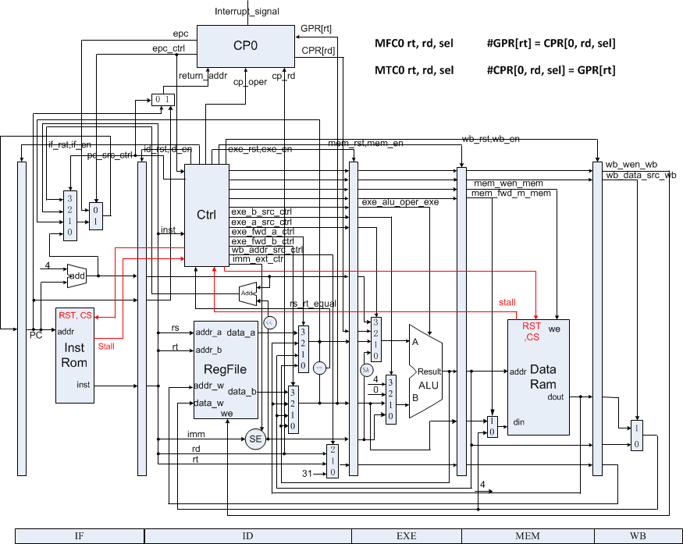
Datapath of CPU accessing Mem. in multiple cycle

Slide 15
Code Example (1)
module inst_rom (
input wire clk,
input wire rst,
input wire cs,
input wire [31:0] addr,
output reg [31:0] dout,
output reg stall
);

Slide 16
Code Example (2)
module data_ram (
input wire clk,
input wire rst,
input wire cs,
input wire we,
input wire [31:0] addr,
input wire [31:0] din,
output reg [31:0] dout,
output reg stall
);

Slide 17
Instr. Mem.(1)
0: 3c010000 lui R1,0x0 //main entry
4: 24210040 addiu R1,R1,64
8: 40811800 mtc0 R1, R3
c: 00001020 add R2,R0,R0
10: 00001820 add R3,R0,R0
14: 40044800 mfc0 R4,R9
18: 00002820 add R5,R0,$0
1c: 20420001 addi R2,R2,1 //loop
20: 28412710 slti R1,R2,10000
24: 1420fffd bne $1,R0,-2 //jump to loop
28: 00000000 nop

Slide 18
Instr. Mem.(2)
2c: 40054800 mfc0 R5, R9
30: 00a42822 sub R5, R5, R4
34: 20420001 addi R2,R2,1 //loop
38: 0800000d j 34
3c: 00000000 nop
40: 20630001 addi R3,R3,1 //handler
44: 42000018 eret
48: 00000000 nop

Slide 19
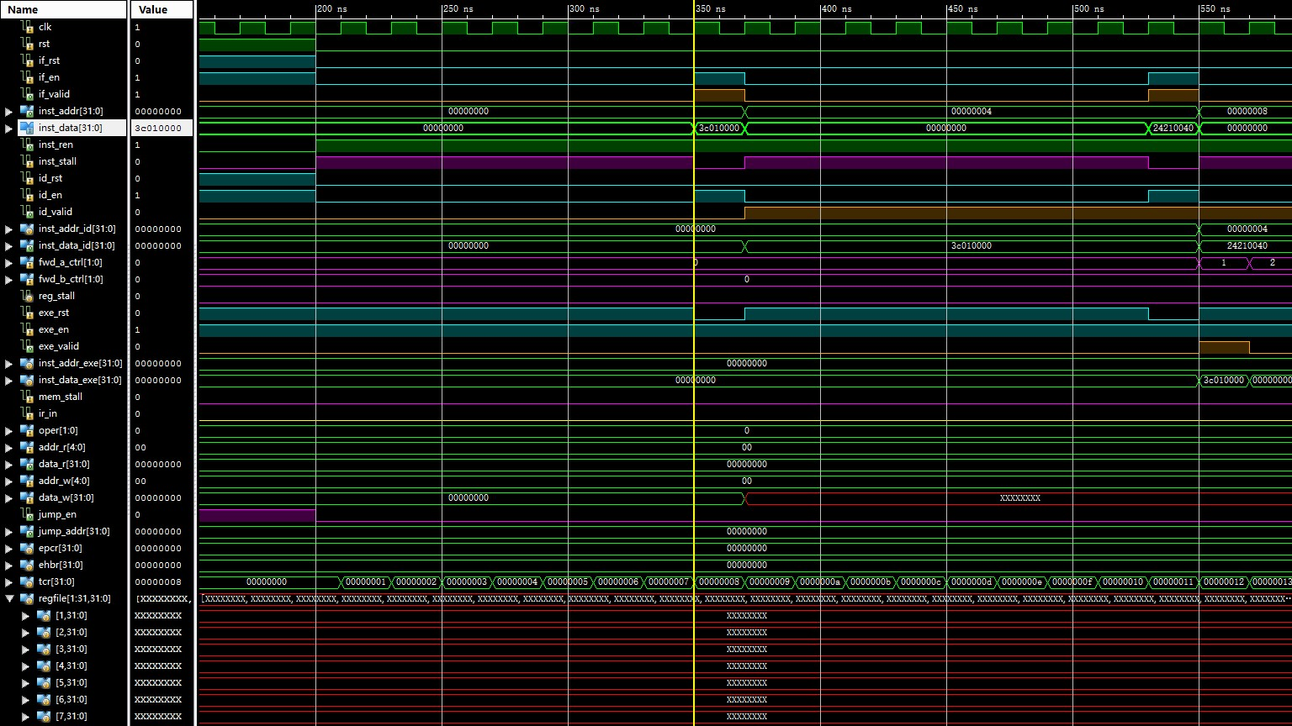
Simulation (1)

Slide 20
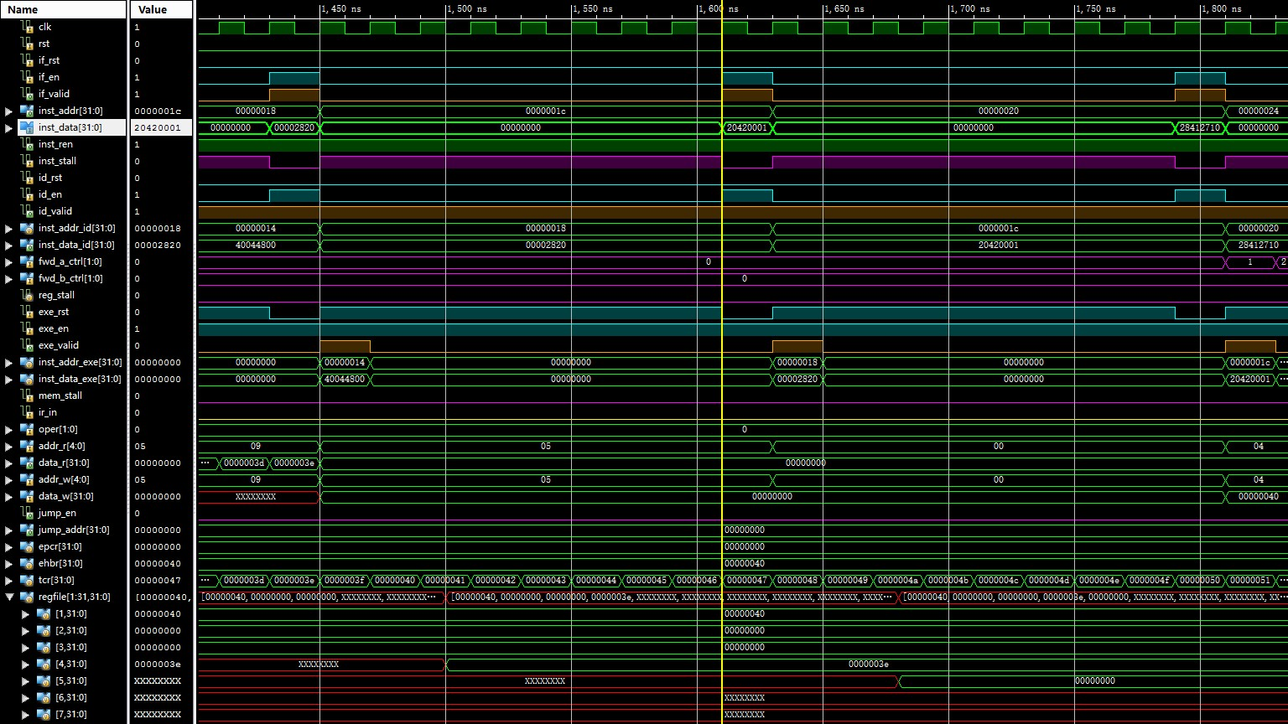
Simulation (2)

Slide 21
Checkpoints
CP 1:
Waveform Simulation of the Pipelined CPU with the verification program
CP 2:
FPGA Implementation of the Pipelined CPU with the verification program

Slide 22
Thanks!

